Slide 1
SAMONA PACIFIC: PRODUCTION PLANNING

Slide 2
Email we received said:
“Are you ready? The first boat with the harvest is on its way to the plant. Everything is set up to start processing in four hours, right? I just sent you an e-mail with the harvest specifications.”

Slide 3
Team & Duties
Determine best production mix based on:
Each harvest’s characteristics
Number of fish, weight, quality etc.
Processing plant capacities
Freezer tunnel, filleting machines etc.
Market conditions
Prices, customer requirements etc.

Slide 4
Company background
Long-standing relationships backed up by contracts that stipulated prices, payment method, and product specifications
The contracts did not specify minimum or maximum quantities of finished products
Our customers are willing to buy all the product SP could produce

Slide 5
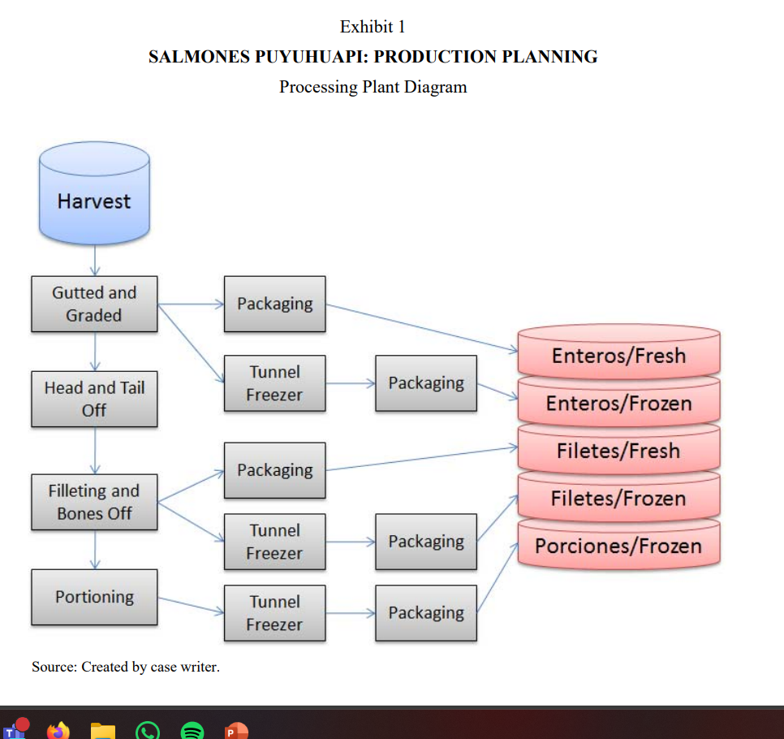
Production flow

Slide 6
Our objective
Maximize profit by assigning each bin of fish to one or more of the five total products based on current prices and expected yields

Slide 7
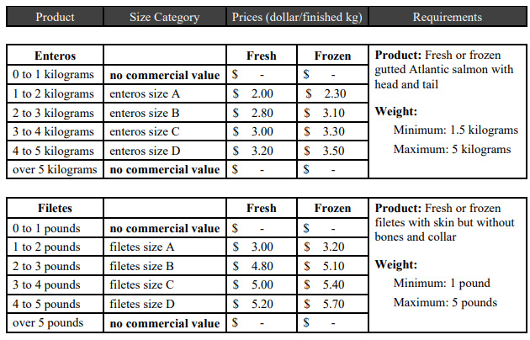
Revenue (1/2)

Slide 8
Revenue (2/2)
It was difficult to predict the number and size of porciones the automatic portioning machine would generate from a filete of any given size. Thus, at the prevailing porciones prices, Perez approximated that revenue per live kilogram from fish converted to porciones would accrue at the rate of $3.78 + 0.032 × (live weight in kilograms). Accordingly, a fish with a live weight of 5 kilograms would bring in revenues of $3.94 per live kilogram, or $19.70 if converted to porciones.

Slide 9
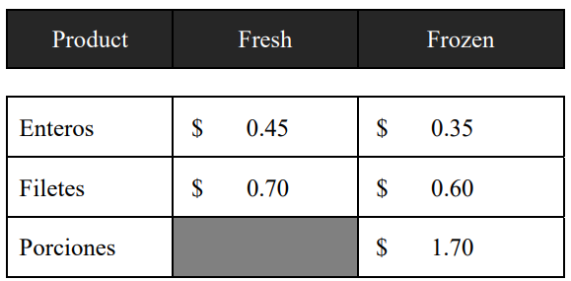
Processing costs

Slide 10
Resources available
Plant operation hours: 16 per day
Filleting machine capacity: 15 fish per minute
Skilled trim workers:
Number of works: 16
Shift duration: 7
Capacity: 10 filetes a minute
Portioning machine capacity: 1,400 fillets per hour
Tunnel freezers: 2
Tunnel freezer capacity: 60,000 pounds per day

Slide 11
Yield
Whole fish- 89%
Fillets- 61%
Portions- 45%

Slide 12
Harvest statistics
Count of fish: 42,000
Normally distributed by weight with mean of 4.3kg and SD of 0.5kg
27 bins of fish

Slide 13
Production plan recommendation

Slide 14
Opportunities for improvement

Slide 15
Impact of freezer restrictions

